Slide 1
Quantum Computing
Hands on with Qiskit

Slide 2
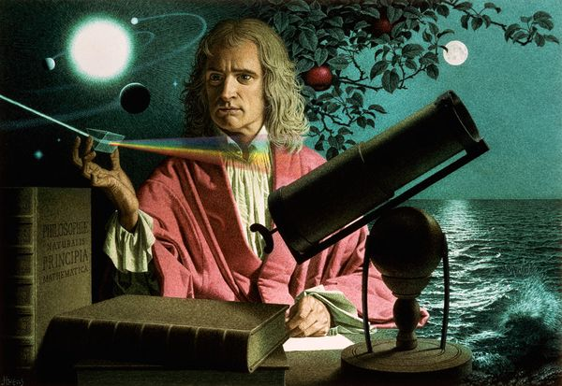
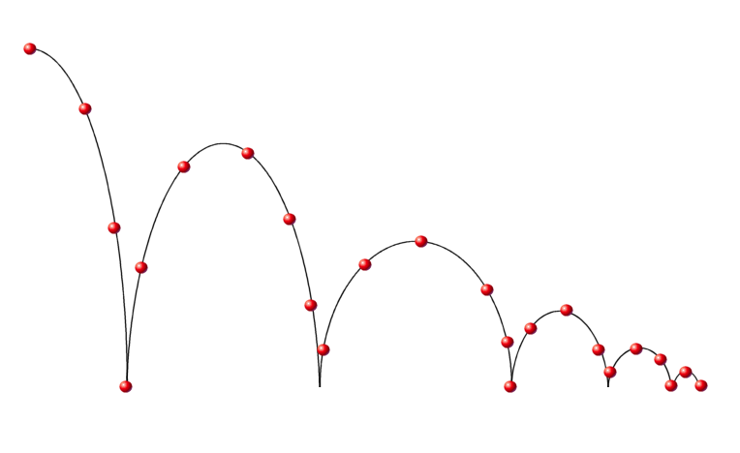
Classical computing (Newtonian Mechanics)
Classical mechanics provide extreme accurate results while dealing with movements of objects in normal scale
The classical theories are simple, but this branch of mechanics cannot be applied to extremely small particles moving at very high speed, as the results may inaccurate

Slide 3
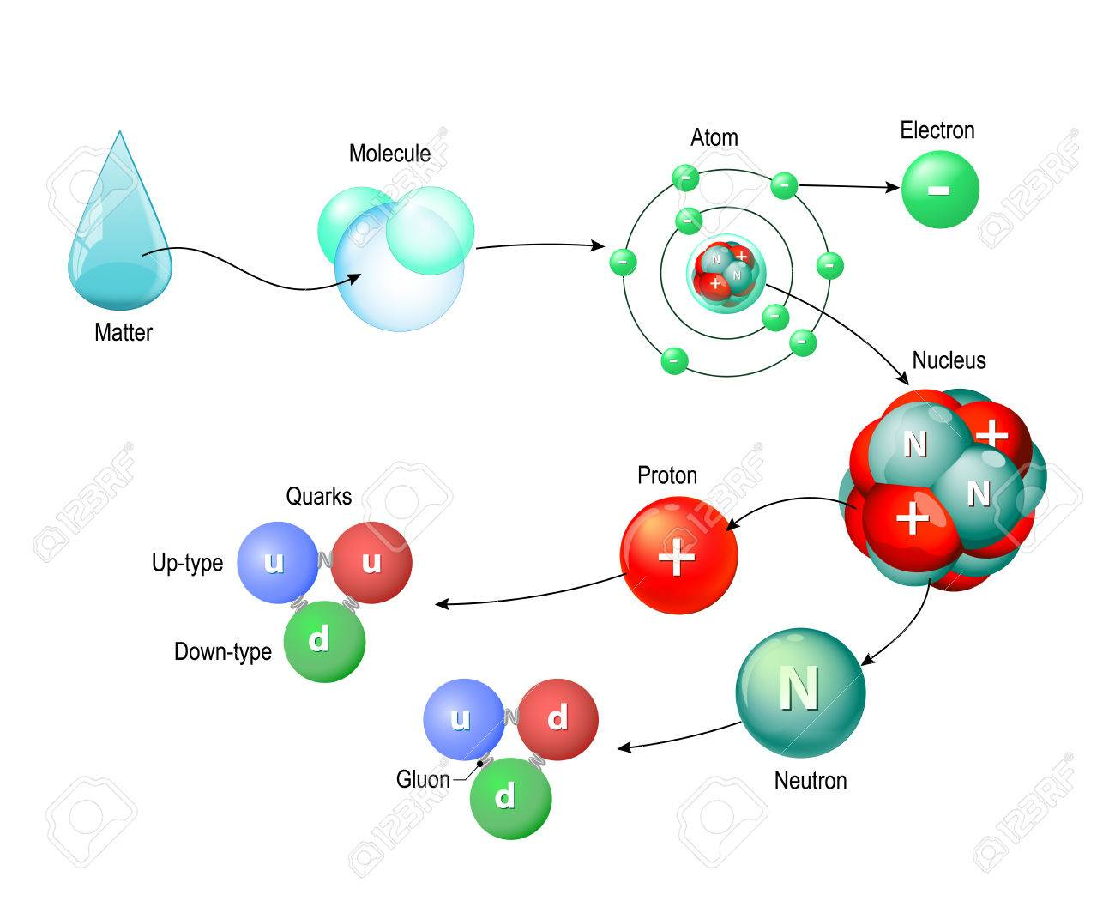
Quantum Mechanics
It is a fundamental theory in physics dealing with the behaviour of matter and energy on the scale of atoms and subatomic particles/waves.

Slide 4
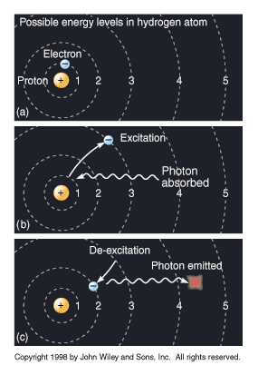
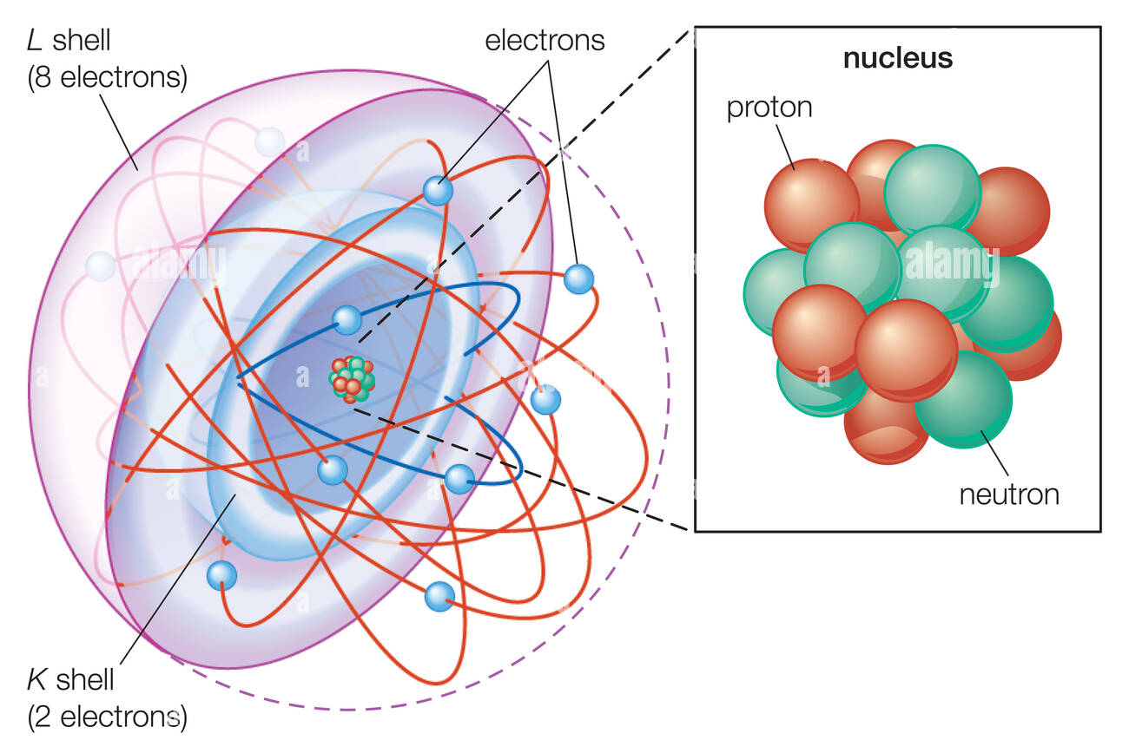
Single Quantum of Energy
Quantum is a discrete packet of energy.
One photon carries exactly one quantum of energy.

Slide 5
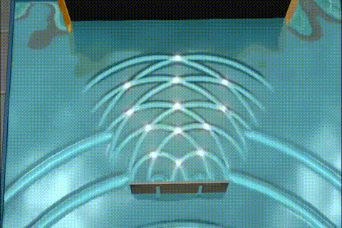
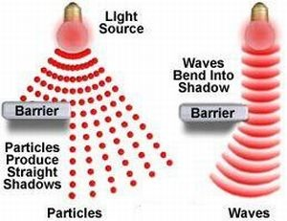
Wave Duality
The dual nature of light means that light can exist as both a particle and a wave.

Slide 6
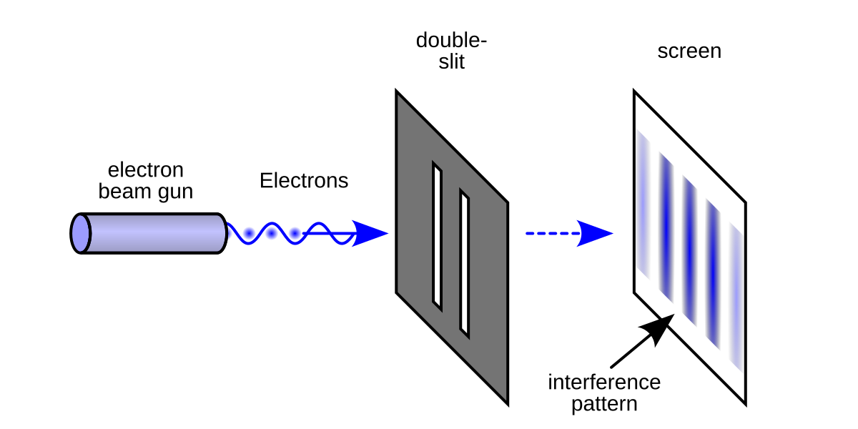
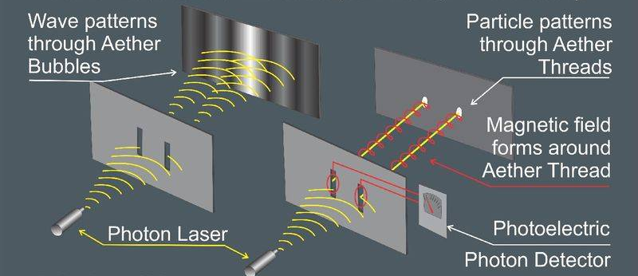
Double Slit
A measurement barrier

Slide 7
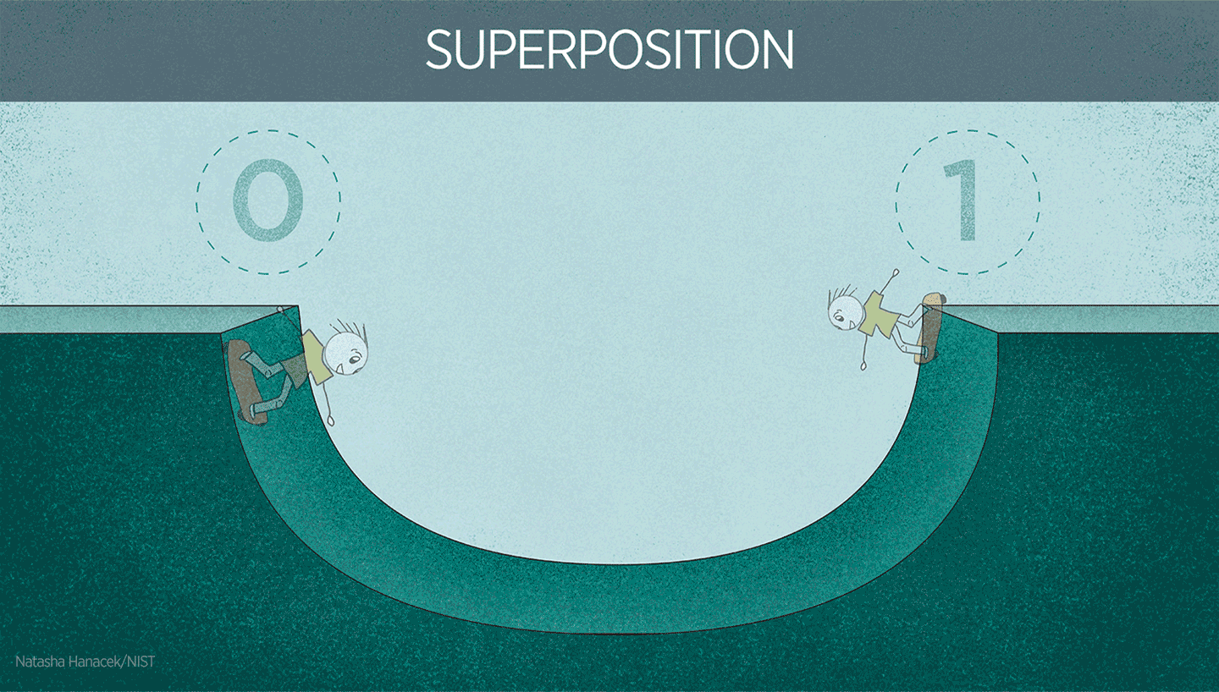
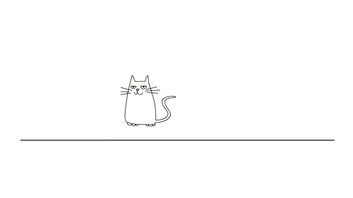
Superposition- Schrödinger's cat

Slide 8
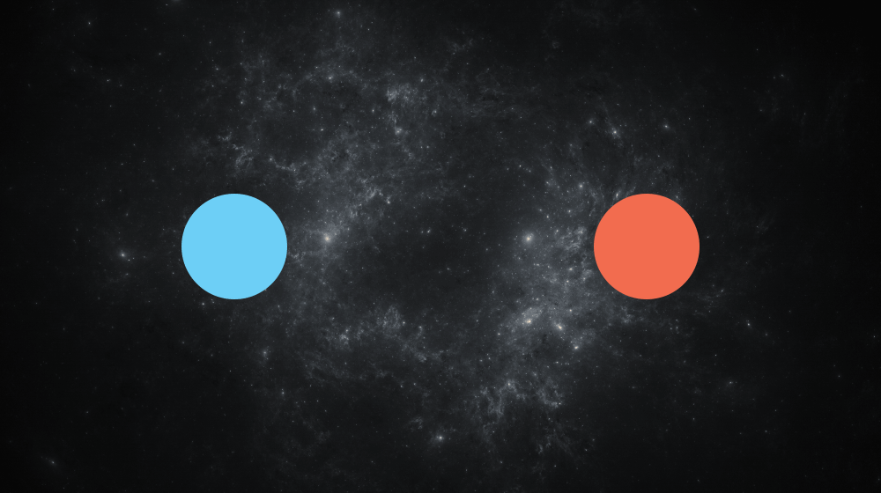
Quantum Entanglement

Slide 9

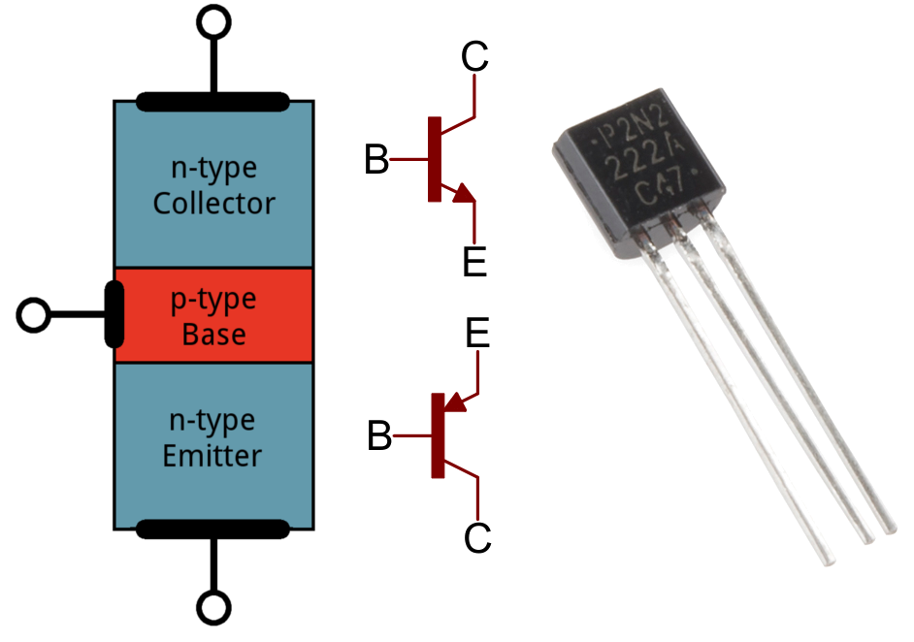
Quantum Tunneling
It is quantum mechanical phenomenon where a sub atomic particle disappears from one side of a potential barrier and appears on the other side without any current.

Slide 10
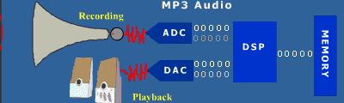
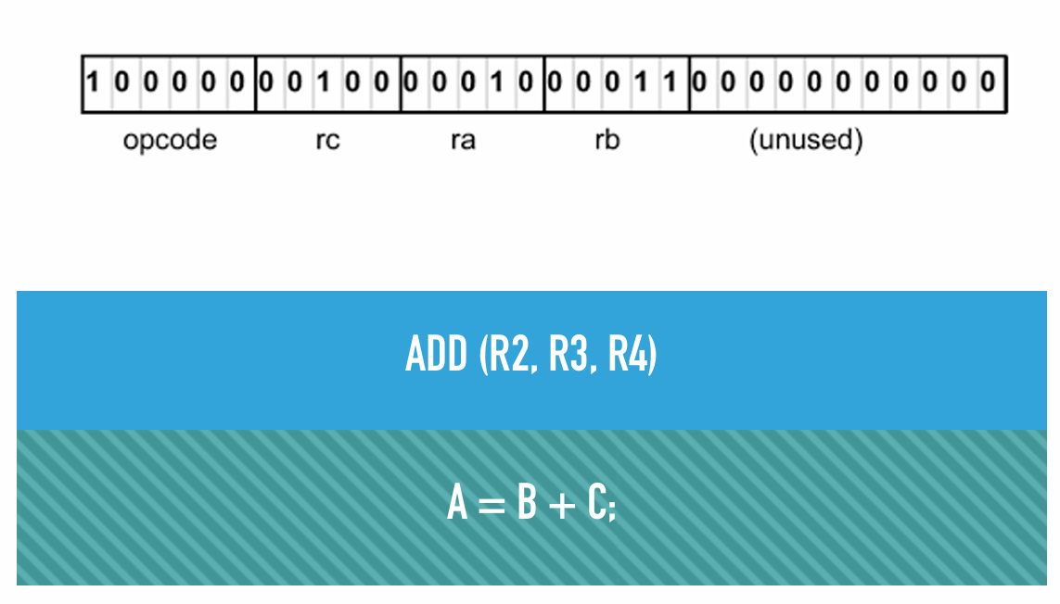
Bit
Machine Learning
Assembly
High level language

Slide 11
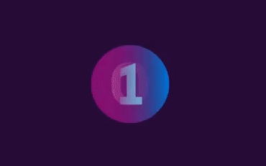
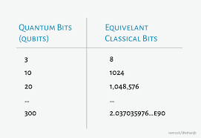
Qubit
It is a basic unit of quantum information.
It can be in 0,1 or superposition of 0 and 1
When they are measured they can be either 0 or 1
There are 2^{n} possible states.

Slide 12
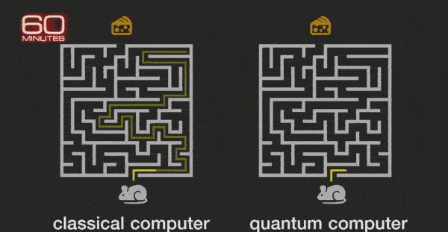
Qubit vs Bit
Classical bit can do only single calculation at a time.
Qubit can exist simultaneously in multiple states.
Adv of qubit- parallel processing.

Slide 13
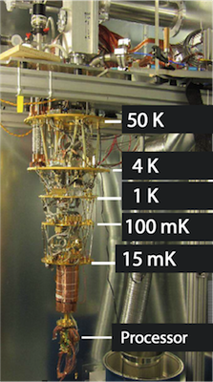
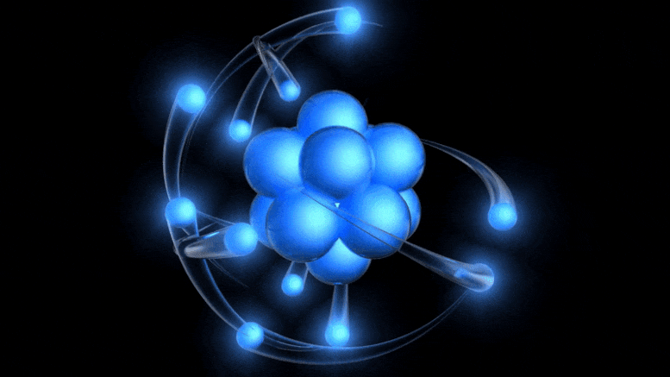
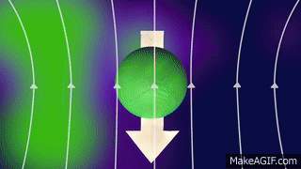
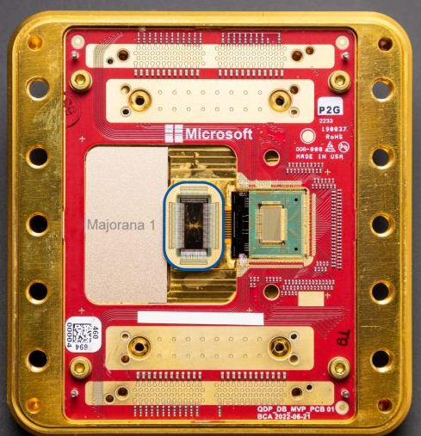
Creating a Quantum Qubit

Slide 14
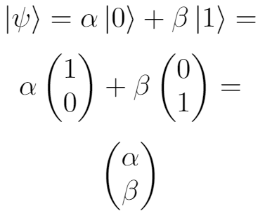
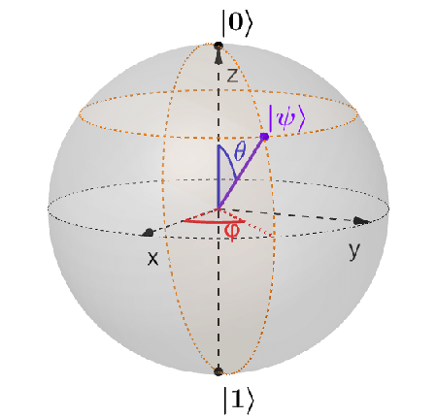
Quantum Qubit State Representation
Qubit needs two more variable to denote its value based on its position in the Bloch sphere.
Bra-Ket notation < | > is used to describe the value of a qubit as a vector in sphere.

Slide 15
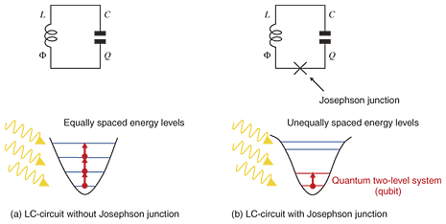
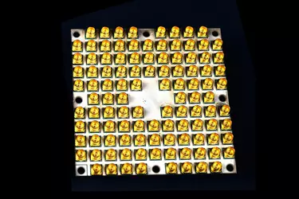
Superconducting Qubit Generation
Natural qubits are isotopes like ¹³C and ²⁹Si
“Non linear LC resonator” oscillation circuit forms man made qubit.
A Josephson Junction(X) is used to restrict the dynamics to two levels.

Slide 16
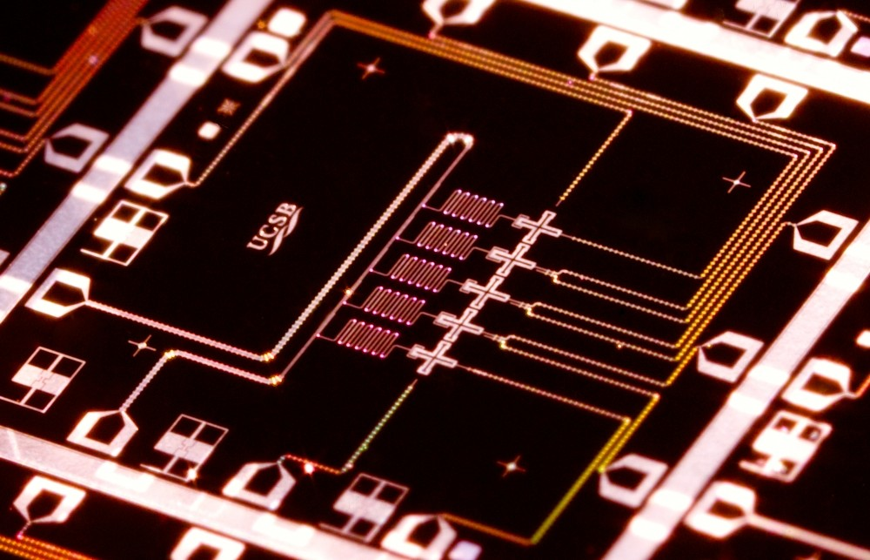
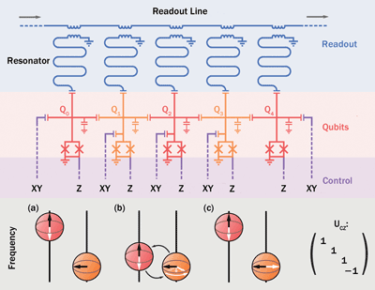
Quantum Bit Readout

Slide 17
Binary
1 1 0 1 1 0 1
= 1 * 2 ^ 6 + 1 * 2 ^ 5 + 0 * 2 ^ 4 + 1 * 2^ 3 + 1 * 2 ^ 2 + 0 * 2 ^ 1 + 1 * 2 ^ 0
= 64 + 32 + 0 + 8 + 4 + 0 + 1
= 109

Slide 18
Hexadecimal
0 1 2 3 4 5 6 7 8 9 A B C D E F
10 11 12 13 14 15
A 4 F 6
=10 * 16 ^ 3 + 4 * 16 ^ 2 + 15 * 16 ^ 1 + 6 * 16 ^ 0
=40960 + 1024 + 240 + 6
=42230

Slide 19
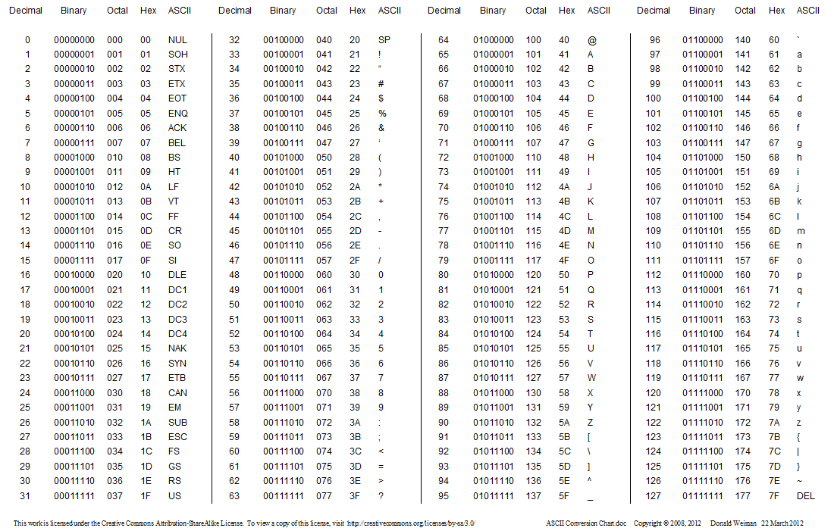
ASCII conversion Chart

Slide 20
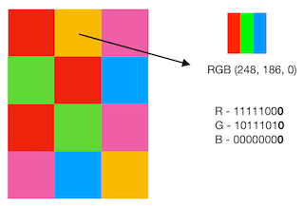
Pixel

Slide 21
Quantum Prerequisites
Qubit notation |0>
Formula E = mc²
Programming language Python

Slide 22

Matrix – Tensor Product
ax
ay
bx
by
a
b
x
y
2
5
7
6
15
21
1
3
2
5
7

Slide 23
Identity Matrix
1 0
0 1
Identity Matrix (I)
XI = X
0 2
3 1
1 0
0 1
0 2
3 1
A⁻¹ = 1/A
AA⁻¹ = I or A⁻¹A = I

Slide 24
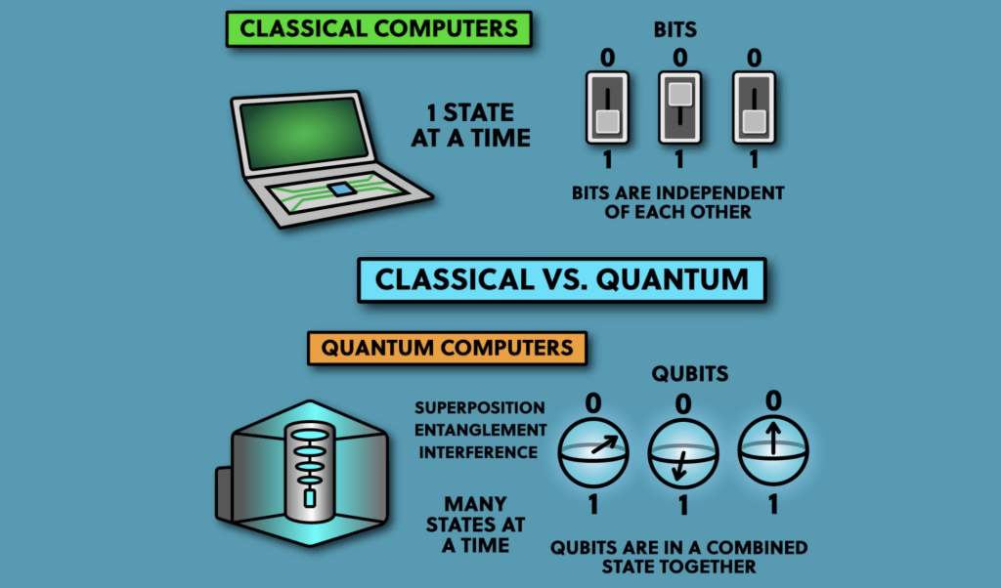
Classical Computers vs Quantum Computer

Slide 25
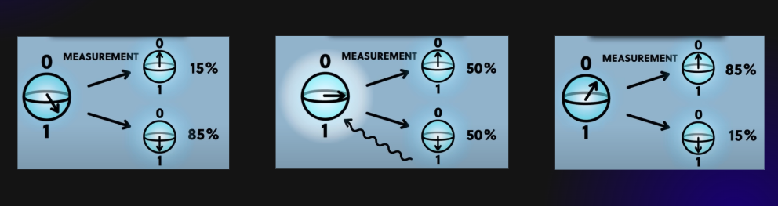
Superposition

Slide 26
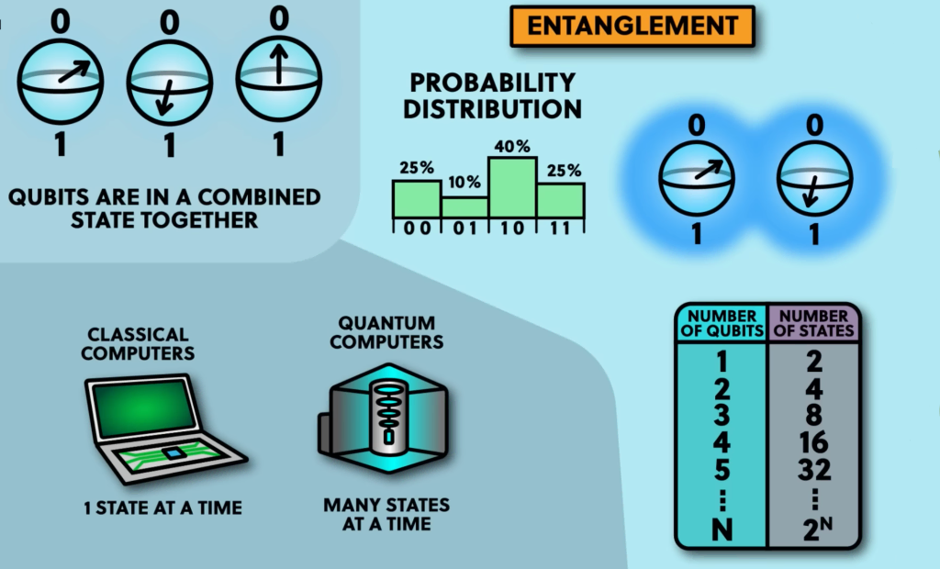
Entanglement

Slide 27
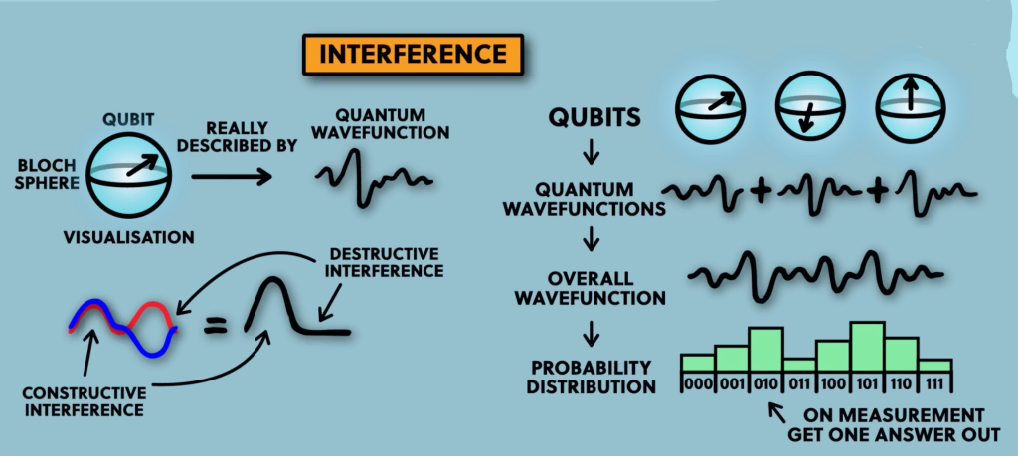
Interference

Slide 28
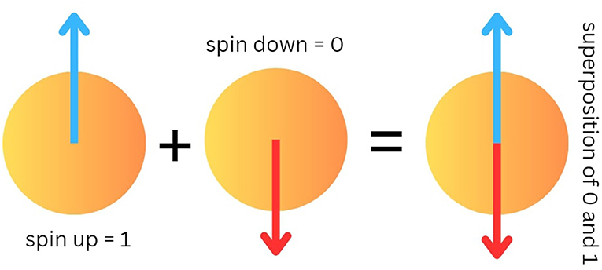
Bra-ket Notation
Bra-ket < A | E >
|1> spin down
|0> spin up
0
1
1
0

Slide 29
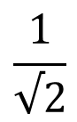
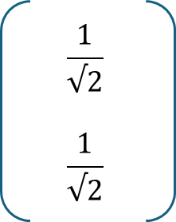
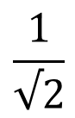
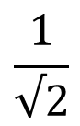
Bra-ket Notation in Superposition
$$\frac{1}{√2}$$
$$\frac{1}{√2}$$
1
0
0
1
$$\frac{1}{√2}$$
$$\frac{1}{√2}$$
$$\frac{1}{√2}$$
( |0> + |1> )

Slide 30
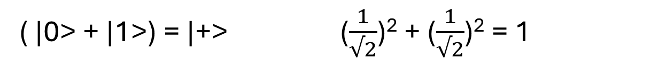
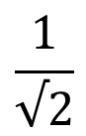
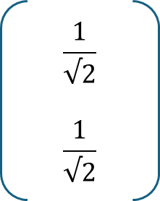
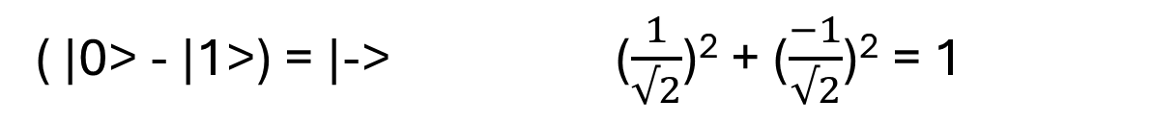
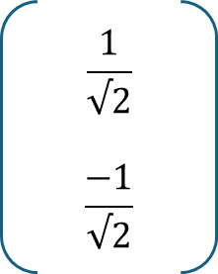
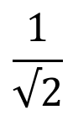
Bra-ket Notation in Superposition-Entanglement
x
y
0
1
1
0
|x|² + |y|² = 1
|1> 0² + 1² = 1
|0> 1² + 0² = 1
$$\frac{1}{√2}$$
$$\frac{1}{√2}$$
$$\frac{1}{√2}$$
( |0> + |1>) = |+> ($\frac{1}{√2}$)² + ($\frac{1}{√2}$)² = 1
$$\frac{1}{√2}$$
$$\frac{−1}{√2}$$
$$\frac{1}{√2}$$
( |0> - |1>) = |-> ($\frac{1}{√2}$)² + ($\frac{−1}{√2}$)² = 1

Slide 31
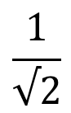
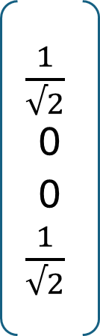
Multi Qubit – Superposition and Entanglement
$\frac{1}{√2}$0
0 $\frac{1}{√2}$
1
0
0
0
0
1
0
0
0
0
1
0
0
0
0
1
00
01
10
11
$$\frac{1}{√2}$$
( |00> + |11> )
|00> |01> |10> |11>

Slide 32
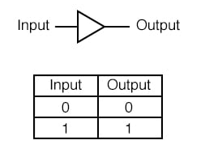
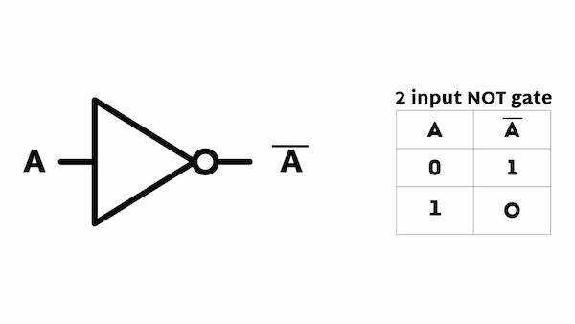
Classical Gates
Buffer Gate
NOT Gate

Slide 33
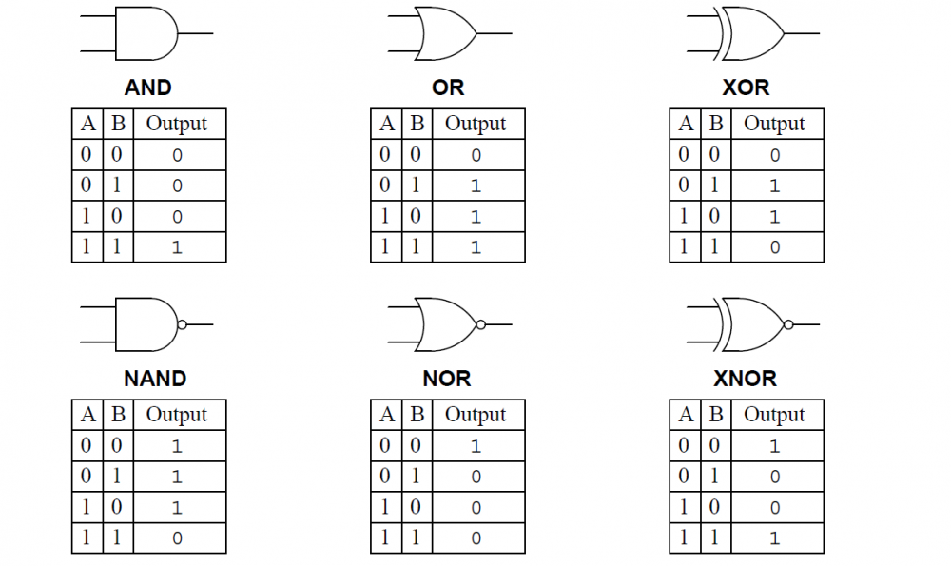
Classical Gates

Slide 34


Quantum Gates – Pauli X

Slide 35

Quantum Gates – Pauli Y
0 -i
i 0
0
1
-i
0
Y|1>
-|i>
0 -i
i 0
1
0
0
i
Y|0>
|i>

Slide 36

Quantum Gates – Pauli Z
1 0
0 1
0
1
0
-1
Z|1>
-|1>
1 0
0 1
1
0
1
0
Z|0>
|0>

Slide 37



Quantum Gates – Hadamard Gate
= |+>
= |->

Slide 38


Quantum Gates – CNOT Gate Matrix
Input (t,c) output(t,c)
Performs X gate on the second qubit (target) if the state of the first qubit(control) is |1>

Slide 39
Quantum Gates – Pauli Z
1 0
0 1
0
1
0
-1
Z|1>
-|1>
1 0
0 1
1
0
1
0
Z|0>
|0>

Slide 40

Quantum Gates – Controlled Z Gate
Just like CNOT applies X gate to target where control is 1,
CZ gate applies Z gate to ‘target’ when the ‘control’ is 1.
Input (t,c) output(t,c)
00 00
01 01
10 10
11 -11

Slide 41




Quantum Gates – Hadamard and CNOT
1
0
1
0
q2 q1 = |0+>
Hadamard * |0> = |+>
(q1) (q1)
CNOT * |0+> = $\frac{1}{√2}$( |00> + |11>)

Slide 42

Multi Qubit
A single bit has 2 possible states 0 and 1.
A qubit has 2 possible states |0> and |1> and complex amplitude.
Two bits have 4 possible states 00 01 10 11
Two qubits requires four complex amplitudes to represent its states.

Slide 43
Quantum Gates – Pauli Y
0 -i
i 0
0
1
-i
0
Y|1>
-|i>
0 -i
i 0
1
0
0
i
Y|0>
|i>

Slide 44


Toffoli gate (Controlled-Controlled-NOT)
A three qubit gate with 2 controls and 1 target.
It performs an X gate on the target only is both controls are in |1>

Slide 45
Deutsch-Jozsa Problem
Consider a binary function f(x) that takes one bit, 0 or 1 as input and outputs either 0 or 1
There are 4 possible combinations.
In 2 cases, the function is balanced (i.e. output is dependent)
In other 2 cases, the function is constant (i.e. output is independent)
Balanced: Constant:
f(0) = 0, f(1) = 1 f(0) = 0, f(1) = 0
f(0) = 1, f(1) = 0 f(0) = 1, f(1) = 1
This can be solved only by evaluating the function twice in classical computer.
But a quantum computer can solve it by evaluating it only once using superposition.

Slide 46

Deutsch-Jozsa Problem
For ‘n’ bit input, we need at least 2^{n-1} +1 evaluations.
Eg: 32 bit problem will take 2³²⁻¹ +1 = 2,14,74,83,649 evaluations.
In quantum computer, this problem can be solved with 100% confidence after only one call to the function f(x) [for a single bit]

Slide 47

Deutsch-Jozsa Problem
Step1: Initialize qubits |0> and |1>
Step2: Place the qubits into superposition
Step3: Pass the inputs into the oracle function
Step4: apply transformation to group and measure output
|0>
H
O_{f}
H
|0>
X
H

